Slide 1


Power point PRESENTATION
Presented by BIZIMA Peace

Slide 2
Content
Introduction
Methodology
Analysis
Results
Conclusion
Recommendations

Slide 3

Introduction
The main focus of this project is thorough analysis of the given dataset(Uber fare dataset) in order to understand the variance of fares in relation to various prominent factors such as time. It is executed using different tools such as Visual studio code, and Power bi that play a significant role in its overall success. The objective is to identify key trends in ride patterns, fare patterns among other significant contributors from the collected uber data and retain meaningful insights. Analyze data in accordance with different criteria such as time, to draw explicit meaning .

Slide 4
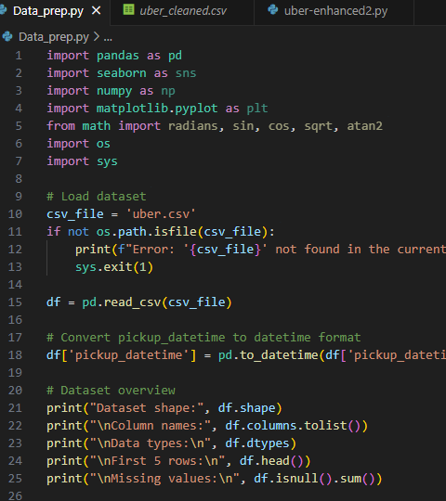

METHODOLOGY
Data Collection is the initial step of this project. Where by the dataset(uber.csv) is obtained/downloaded from Kaggle.
Thereafter the data is loaded in the Visual studio code. This process involves the importation of several libraries such as pandas, seaborn, and matplotlib.
The

Slide 5
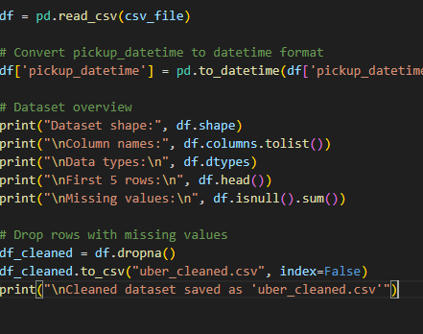
Data cleaning
Data cleaning is then carried out to handle missing values then after the execution of these codes we obtain a clean version of the dataset labeled (uber_cleaned.csv).
This process enhances data accuracy and reliability.

Slide 6
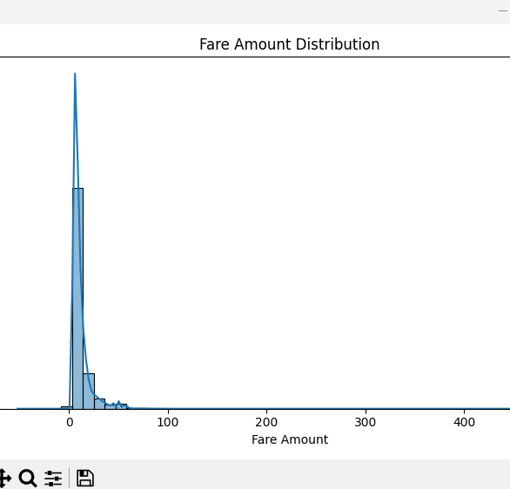
EDA
Exploratory Data Analysis also known as EDA, it is carried out to understand dataset structure and dimensions, description of data types and variables.
It plays a vital role in discovering patterns, distributions, and relationships within the dataset. It also serves as a data quality assessment. Across is a right skewed fare amount distribution illustration.

Slide 7
Feature Engineering
There was introduction of new features such as hour, day, and month from pickup datetime. It also brings about peak/peak off indicators and integrates other analytical features as well to the dataset in order to enhance its capabilities. Hereafter, it was saved as(uber_enhanced.csv).

Slide 8
analysis
Crafting an engaging, impactful, and professional presentation

Slide 9
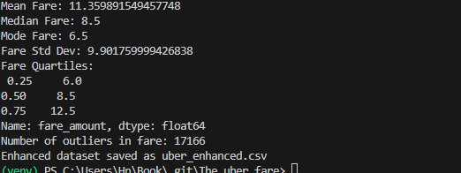
Descriptive statistics
Skewed Distribution: Mean fare ($11.36) > median ($8.50) > mode ($6.50), indicating right-skewed data with many low-cost trips and a few high fares.
High Variability: Large standard deviation ($9.90) and IQR ($6.00–$12.50) show significant fare fluctuations.
Outlier Impact: 17,166 outliers suggest premium/long trips or data errors needing review.
Typical Trip Cost: Most fares cluster around $6.50 (mode), with 50% of trips under $8.50.
Data Segmentation Recommended: Separate standard trips (middle 50%: $6–$12.50) from outliers for clearer insights.
Next Steps: Investigate outliers, visualize distribution, and consider transformations for analysis.

Slide 10
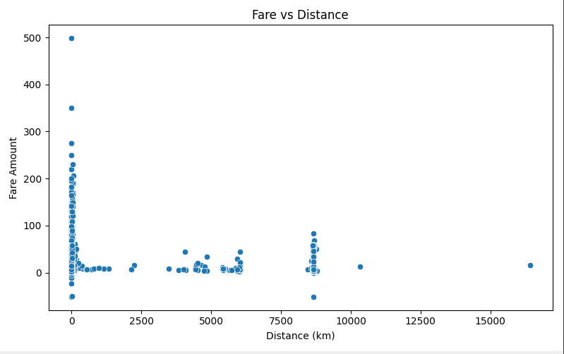
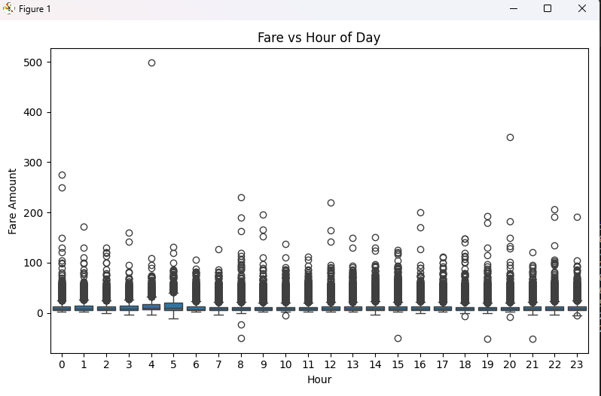
INSIGHTS
Based on the Fare vs Distance graph we can conclude that majority of rides are short-distance since most data points are clustered at distances below 1000 km.
In accordance with the Fare vs Hour of day graph, the Fare distribution is relatively stable throughout the day since the median fare stays consistent across all hours.

Slide 11
Results

Slide 12

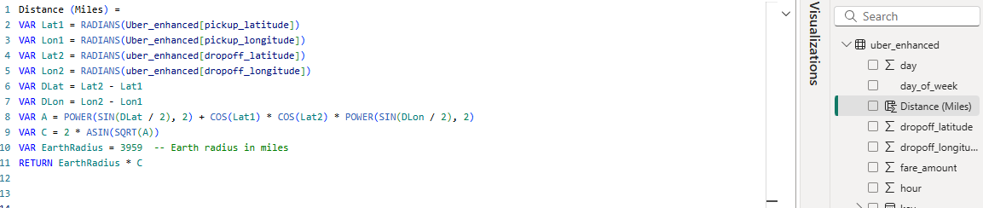
DAX FORMULAS
Dax formulas were implemented in the
Power bi to add a column named season.
Which assigns rides to a their respective
seasons which is essential in the analysis
of season trends.
Another dax formula was put in place to
calculate the straight line distance between pickup
and dropoff points which is essential in ride patterns
analysis.

Slide 13

BUSIEST PERIODS
The most common ride days are Thursdays and Friday, probably because of the social activities and work routines associated with them.
As for the peak hours of uber rides are evening hours.

Slide 14
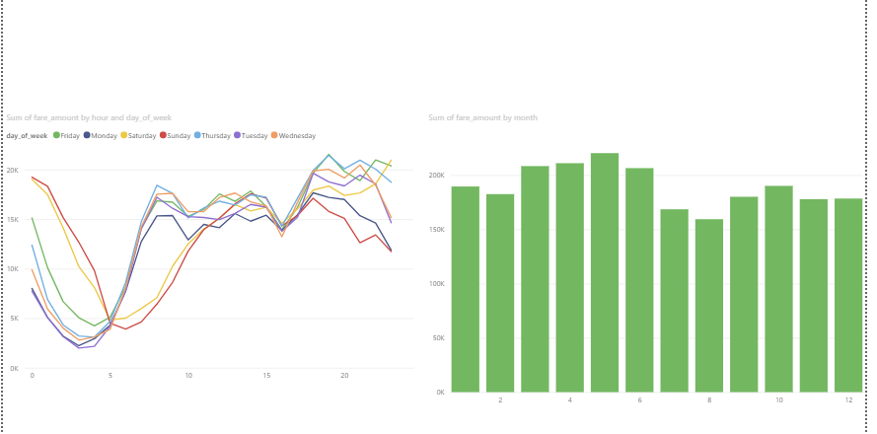
Fare patterns

Slide 15
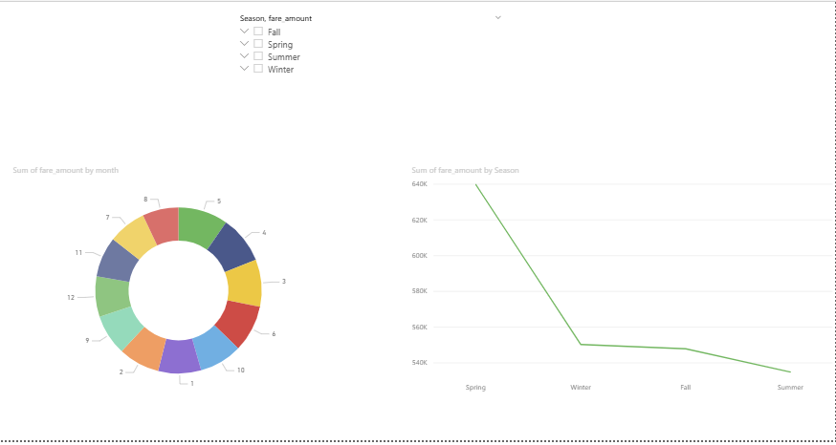
Season trends

Slide 16
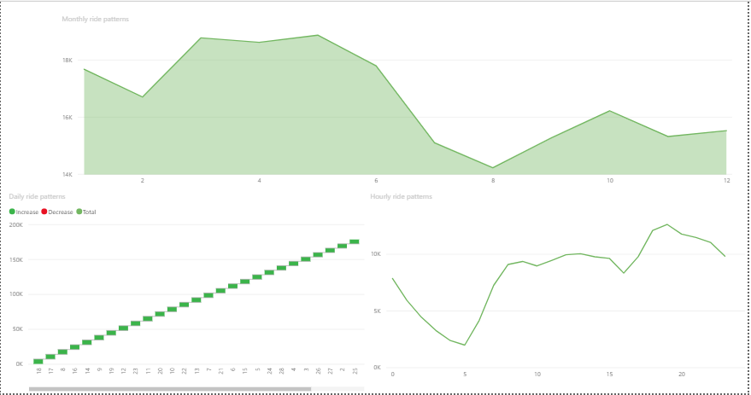
RIDE PATTERNS

Slide 17
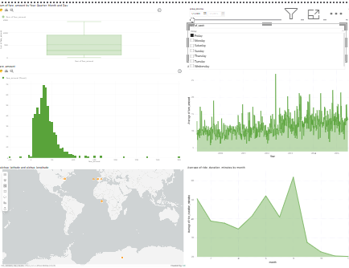
Dashboard

Slide 18
Conclusion
The analysis of the Uber Fares Dataset uncovered several important operational insights such as ride demand peaks during evening rush hours, particularly on Thursdays and Fridays, highlighting high commuter activity during the end of the workweek and high ride volumes in spring .
Not to forget the Fare vs Hour of Day analysis shows that shows the consistency of fare amount throughout the day indicating stable pricing independent of the time of ride.
Overall the demand pattern and other prominent factors such as pricing should be measured against various criteria such as time ,seasons, fare amount and so on, to obtain a well versed ground for enhaced decision making.

Slide 19

RECOMMENDATIoNS
Optimize Driver Allocation During Peak Hours Allocate more drivers during evening rush hours—especially on Thursdays and Fridays—to meet increased demand and reduce passenger wait times. This can improve customer satisfaction and maximize revenue.
Targeted Promotions in Low-Demand Periods Offer discounts or loyalty rewards during non-peak hours or days (e.g., early mornings or mid-week) to stimulate demand and balance ride volume more evenly across the day and week.
Seasonal Pricing Strategy Maintain high service availability in spring to support the higher ride volume and improve customer retention.
Focus on Short-Distance Services Since the majority of rides are short-distance, consider enhancing micro-transit or pooled ride options in densely populated areas to increase trip frequency and operational efficiency.

Slide 20
END
Keeping your audience engaged through effective techniques

